Slide 1
Natural Language Processing Specialization Vector Space Models
(2020 Deeplearning.ai)
YangXi’s Reading Notes

Slide 2
Why learn vector space models
Represent words and documents as vectors
Similar sentence can have very different meaning
“Where are you heading?”
“Where are you from?”
Completely different sentences can have the same meaning
“what is your age?”
“How old are you?”
The representation captures relative meaning
“You eat cereal from a bowl”
“You buy something and someone else sells it”

Slide 3

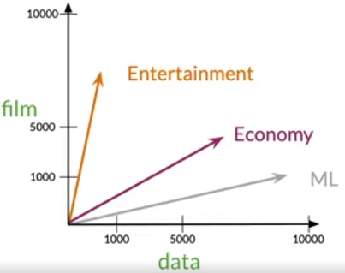
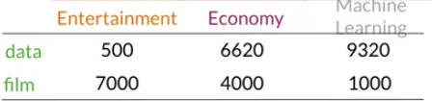
Word-by-Word(W/W) and Word-by-Doc(W/D)
Co-occurrence of words in Word-by-Word (W/W) design
Number of times they occur together within a certain distance k
For example,
“I like simple data”
“I prefer simple raw data”
With k = 2
The words “data” and “simple” occurred 2 times
Co-occurrence of words in Word-by-Doc (W/D) design
Number of times a word occurs within a certain category
Vector Space of Documents

Slide 4
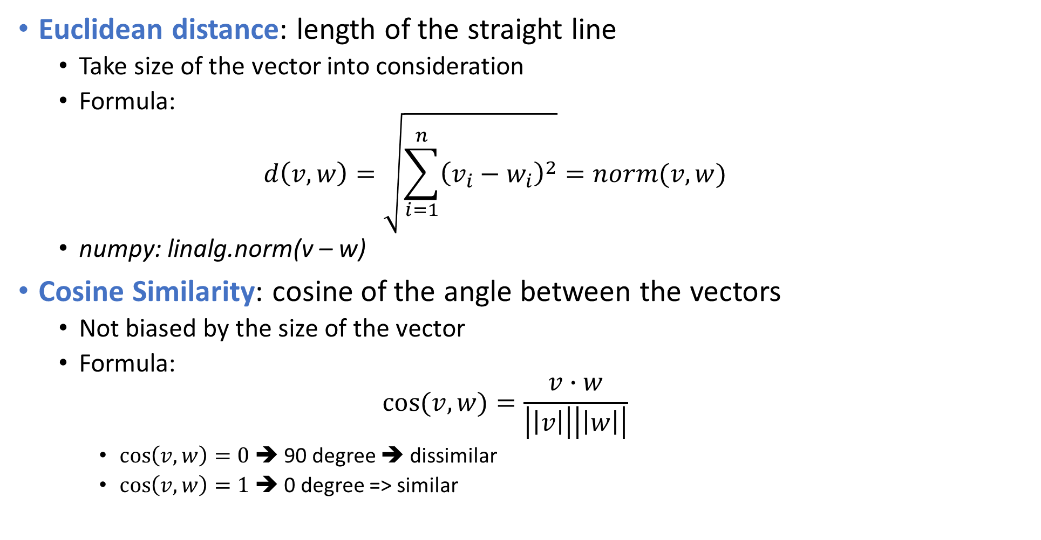
Distance and Similarities
Euclidean distance: length of the straight line
Take size of the vector into consideration
Formula: $d\left(v,w\right)=\sqrt{\sum_{i=1}^{n}{{\left(v_{i}−w_{i}\right)}^{2}}}=norm(v,w)$
numpy: linalg.norm(v – w)
Cosine Similarity: cosine of the angle between the vectors
Not biased by the size of the vector
Formula: $cos⁡(v,w)=\frac{v∙w}{\left|\left|v\right|\right|\left|\left|w\right|\right|}$
$\cos\left(v,w\right)=0$ ➔ 90 degree ➔ dissimilar
$\cos\left(v,w\right)=1$ ➔ 0 degree => similar

